Slide 1




NEXT GEN EMPLOYABILITY PROGRAM
Creating a future-ready workforce
Team Members
College Name
Student Name : Ashikha S.R
Student ID : au960221104031
Arunachala college of engineering for women

Slide 2

CAPSTONE PROJECT SHOWCASE
Project Title
Car Rentals Application with Django Framework
Abstract | Problem Statement | Project Overview | Proposed Solution | Technology Used | Modelling & Results | Conclusion

Slide 3
Abstract
The car rentals application built on Django framework offers a streamlined platform for both customers and administrators to efficiently manage car rental services. With user-friendly interfaces, customers can browse, reserve, and manage bookings effortlessly, while administrators can oversee car and booking management seamlessly. Key features include user authentication, car inventory management, reservation system, and booking administration. Optional functionalities such as payment integration, rigorous testing, and security measures further enhance the application's reliability and usability. Leveraging Django's robust framework, the application ensures scalability, security, and optimal performance, providing a comprehensive solution for car rental businesses.
Source :

Slide 4
Problem Statement
Design and develop a web application for a car rental company that allows users to browse available cars, make reservations, and manage their bookings. The application should have separate interfaces for both customers and administrators.
Source :

Slide 5
Project Overview
User Authentication:
Secure login for customers and administrators.
Car Inventory:
Manage car details and availability.
Browsing:
User-friendly interface for browsing available cars.
Reservations:
Allow customers to reserve cars for specific dates.
Booking Management:
Admin interface to manage bookings efficiently.
User Dashboard:
Personalized dashboards for users to manage activities.
Payment Integration:
Optional integration of secure payment gateways.
Source :

Slide 6
Proposed Solution
1. User Authentication and Authorization:
Implement user authentication using Django's built-in authentication system.
Define user roles such as customer and administrator.
Implement authorization to restrict access to certain functionalities based on user roles.
2. Car Management:
Create a database model for storing car information such as make, model, year, availability, and price.
Develop CRUD (Create, Read, Update, Delete) functionality for managing cars.
Implement filtering and search functionality to allow users to easily find cars based on various criteria.
3. Reservation System:
Design a reservation system where customers can view available cars and reserve them for specific dates.
Implement validation to ensure that a car is available for the selected dates.
Allow customers to view their reservations and modify or cancel them if needed.
Source :

Slide 7
4. Booking Management:
Develop an administrative interface for managing bookings.
Allow administrators to view all bookings, edit booking details, and cancel bookings if necessary.
Implement filtering and search functionality to facilitate easy management of bookings.
5. User Interface:
Design a user-friendly interface for both customers and administrators.
Utilize Django's template engine to create HTML templates for different pages.
Ensure responsiveness and accessibility for various devices and screen sizes.
6. Payment Integration (Optional):
Integrate a payment gateway to facilitate online payments for bookings.
Implement secure payment processing using industry-standard protocols.
Allow customers to view their payment history and invoices.
Source :

Slide 8
7. Testing and Deployment:
Write unit tests to ensure the reliability and stability of the application.
Perform thorough testing to identify and fix any bugs or issues.
Deploy the application to a production environment, ensuring scalability and reliability.
8. Security Considerations:
Implement measures to prevent common security vulnerabilities such as cross-site scripting (XSS) and SQL injection.
Use HTTPS to encrypt data transmitted between the client and server.
Implement proper authentication and authorization mechanisms to protect sensitive functionalities.
9. Performance Optimization:
Optimize database queries and application logic to ensure fast response times.
Implement caching mechanisms to reduce the load on the server.
Monitor application performance and scale resources as needed to handle increased traffic.
Source :

Slide 9


Technology Used
Front-end
Back-end
Source :

Slide 10
Modelling & Results
Modelling
User Authentication: Utilize Django's authentication system for secure user login.
Car Inventory: Implement database model for car details including availability.
Reservation System: Develop schema to manage reservations, linking users with booked cars.
User Roles: Define models for customers and admins with distinct permissions.
Results
Customer Interface: User-friendly browsing and reservation features.
Admin Interface: Efficient management of car inventory and bookings.
Reservation Handling: Customers can view, modify, or cancel bookings.
Secure Access: Authentication ensures data security for both users and admins.
Source :

Slide 11
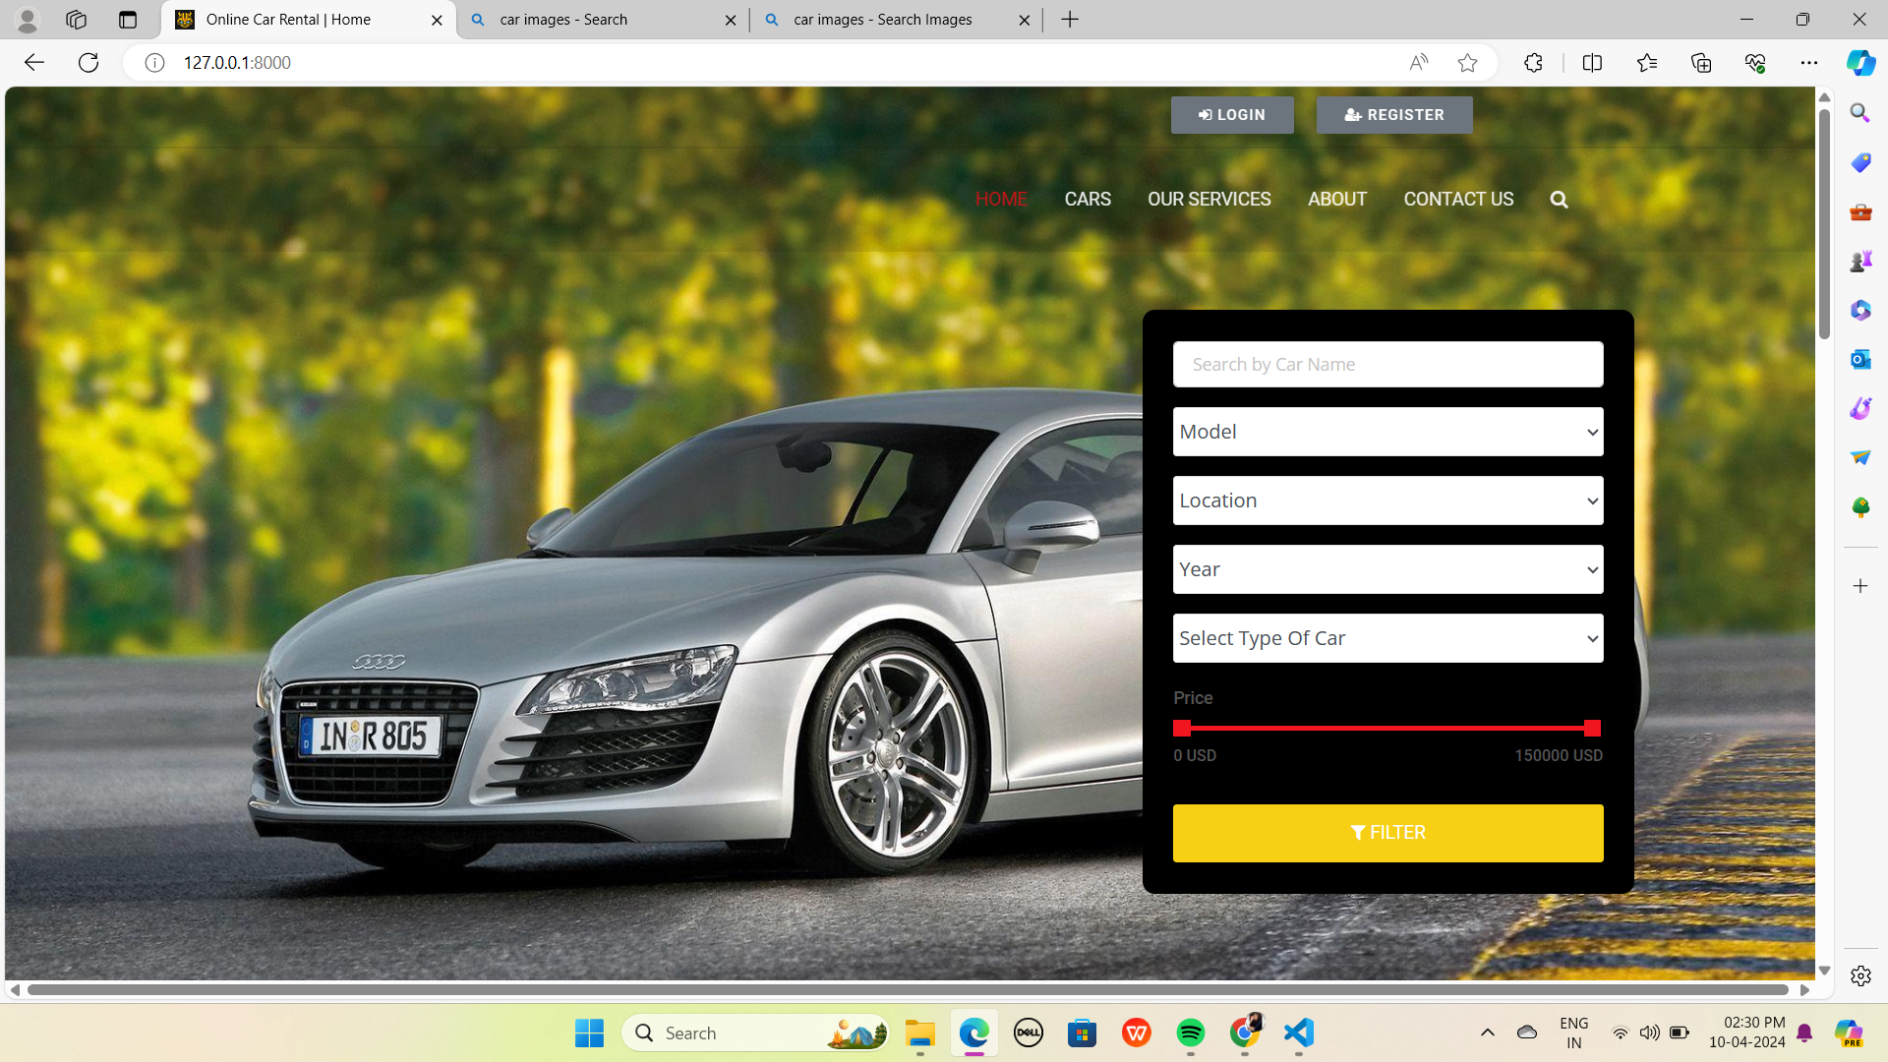
Homepage

Slide 12
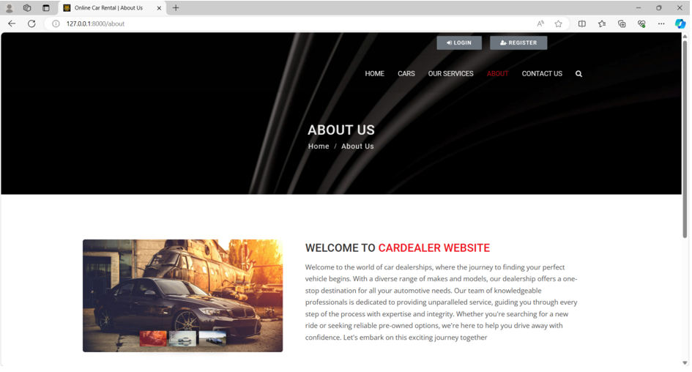
About-Us-Page

Slide 13
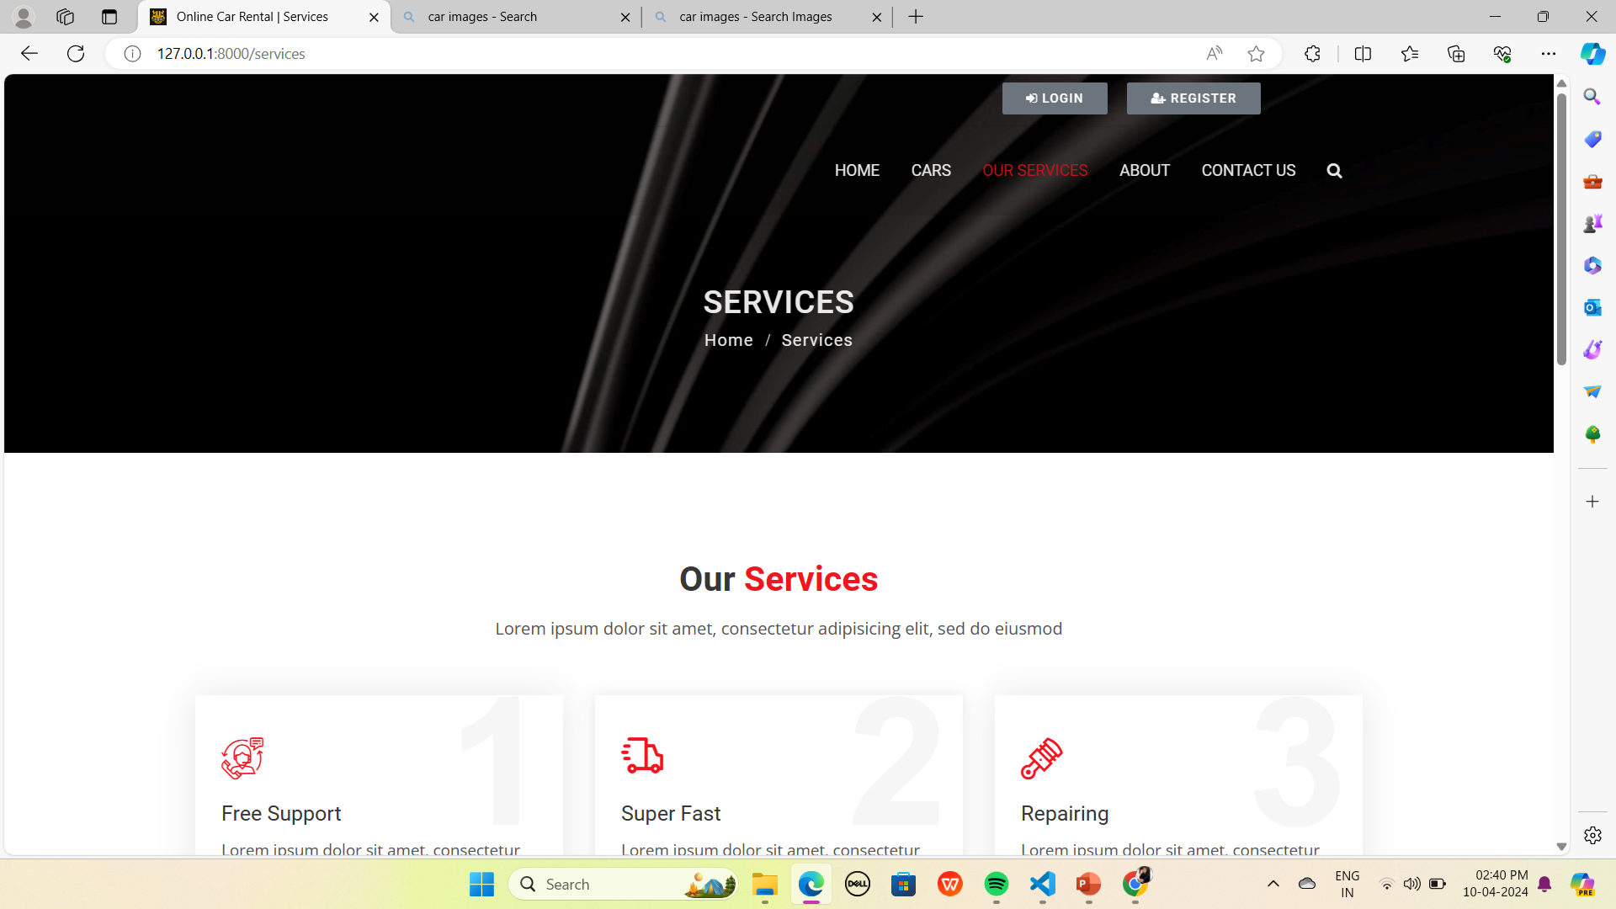
Service-Page

Slide 14
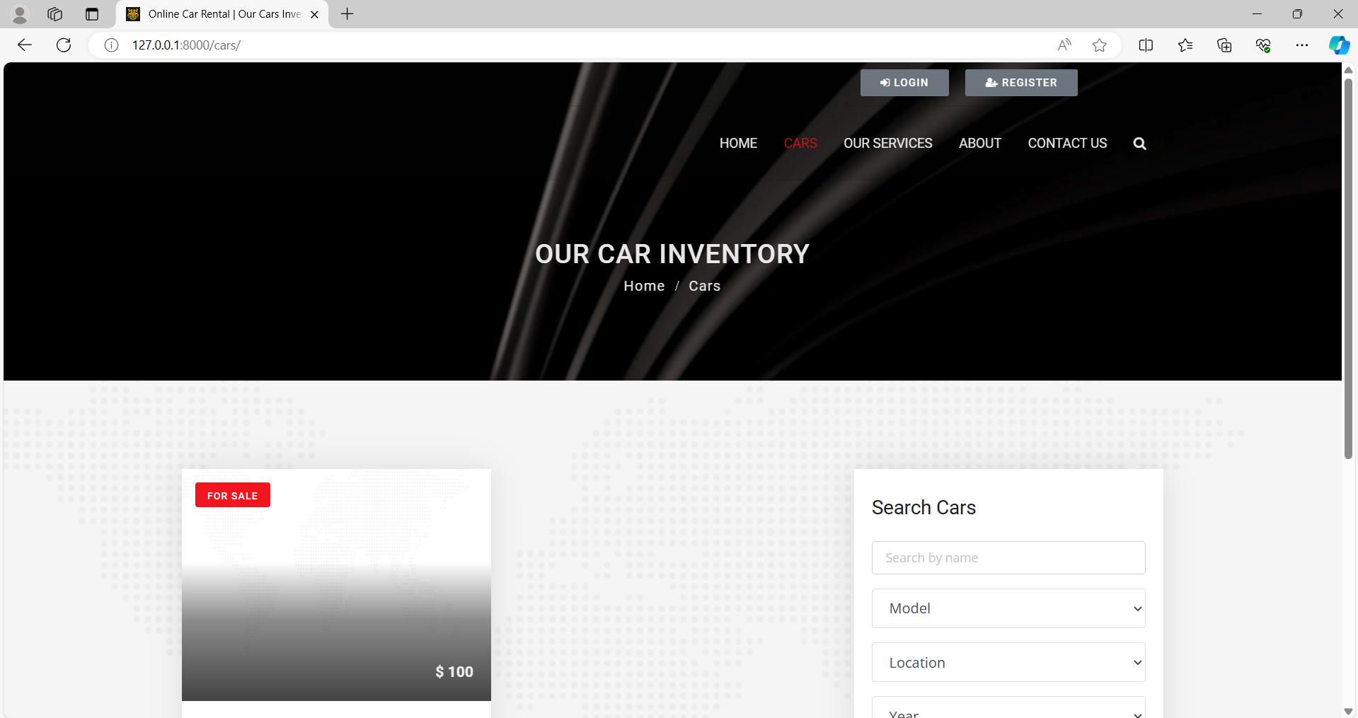
Departments-Page

Slide 15
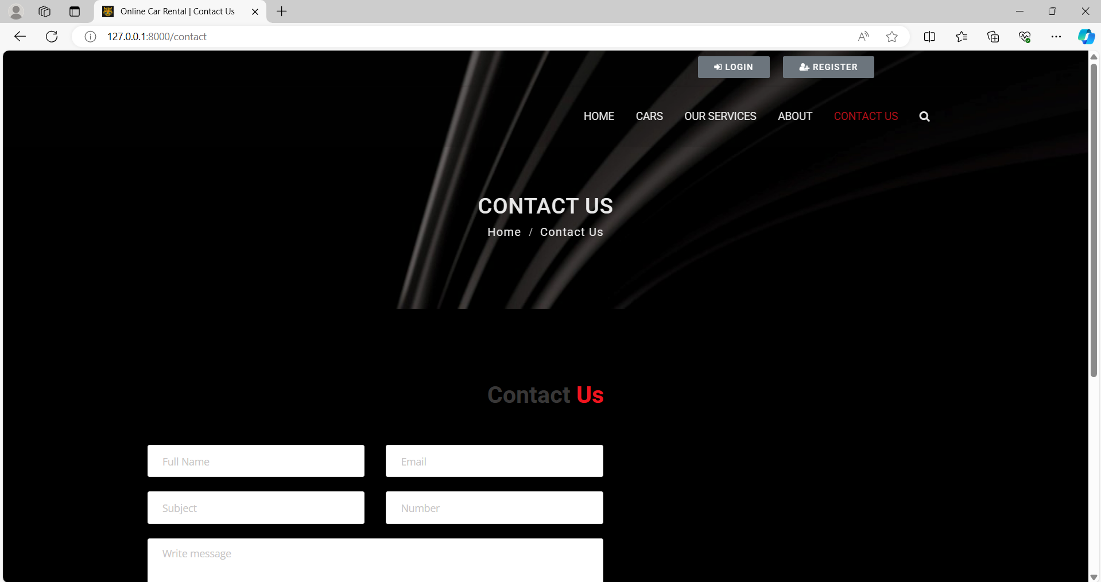
Blog-Page

Slide 16
Future Enhancements:
Vehicle Maintenance Tracking: Implement a system to track vehicle maintenance schedules and alerts, ensuring optimal performance and safety for rental cars.
Peer-to-Peer Car Sharing: Expand services to include peer-to-peer car sharing, allowing individuals to rent out their vehicles when not in use, creating additional revenue streams.
Integration with Smart Devices: Enable seamless integration with smart devices and IoT technology to unlock or locate rental cars, enhancing convenience for users.
Voice-Activated Commands: Introduce voice-controlled functionalities to facilitate hands-free browsing, booking, and management tasks for users.
Integration with Travel Planning Platforms: Collaborate with travel planning platforms to offer integrated car rental options, providing users with seamless travel experiences from start to finish.

Slide 17
Conclusion
By following the outlined solution, you can develop a robust and feature-rich car rentals application using the Django framework. Make sure to adhere to best practices in software development, security, and performance optimization throughout the development process.
Source :

Slide 18
Thank You!
Notes:
Thank You !!

